Slide 1
Analysis of Bank Loan

Slide 2
AGENDA
Introduction
Project Objective
KPI’s
Dashboard
Conclusion

Slide 3
INTRODUCTION
Overview of the Project :
Analytics of Bank loan of customers project focuses on analyzing the bank loan data of customers to understand patterns, identify potential risk factors, and provide actionable insights.
Importance of Bank Loan Analytics :
Analyzing customer loan data accurately helps banks make better loan decisions, reduce risks, and keep customers happy.

Slide 4
PROJECT OBJECTIVE
To study customer profiles and how loans are given out.
To find what affects loan approvals and defaults.
To suggest ways to increase loan approvals and lower defaults.

Slide 5
Key Performance Indicators
KPI-1
Year wise loan amount stats
KPI-2
Grade and sub grade wise Revol_ bal
KPI-3
Verified vs Non-verified Status
KPI-4
State wise and month wise loan status
KPI-5
Home ownership vs last payment date

Slide 6
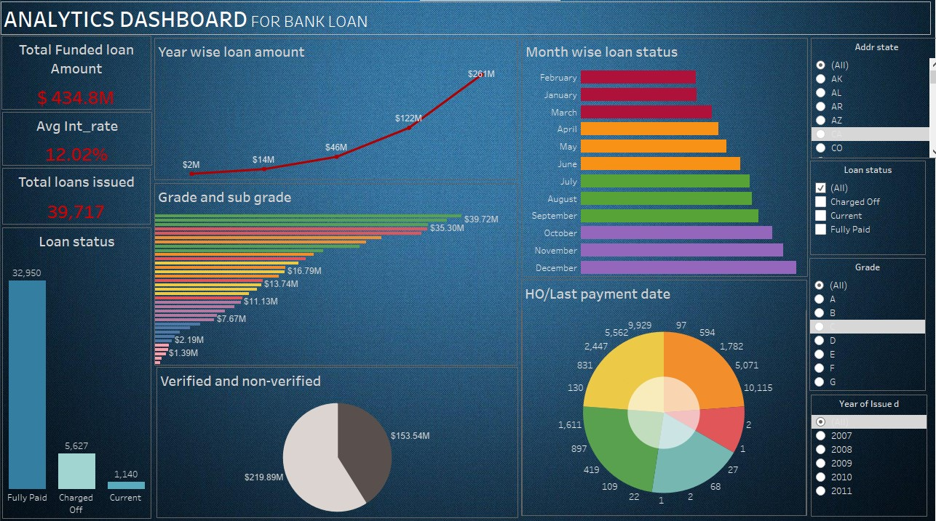
DASHBOARD

Slide 7
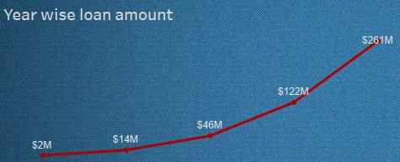
KPI 1 - Year wise loan amount Stats
About : Breakdown of loan amounts distributed each year
Observation : The line chart indicates that 2007 had the lowest total loan amount requested, while 2011 saw the highest total loan amount requested. This trend highlights a significant increase in loan requests over this period.

Slide 8
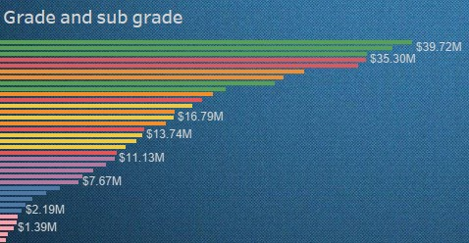
KPI 2 - Grade & sub-grade wise revol_bal
About : Grade and sub-grade wise revolving balance
Observation : This bar chart illustrates the revolving balance for each grade and sub-grade, with different colors used to represent each sub-grade within a grade. This visualization allows us to easily identify which grades or sub-grades have the highest and lowest revolving balances.

Slide 9
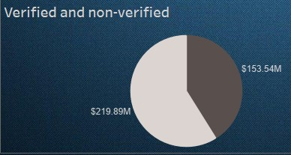
KPI 3 - Total payment for verified and non verified status
About : Display total payment for verified and non-verified status
Observation : This pie chart shows the total payments made by verified and non-verified borrowers. Filters have been applied in dashboard to explore the payment distributions for different years and grades, allowing us to compare verified and non-verified borrowers across various categories.

Slide 10
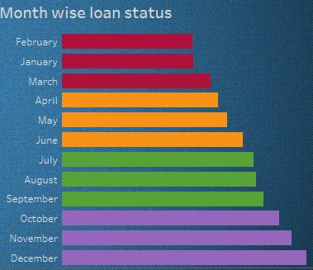
KPI 4 - State wise and month wise loan status
About : This chart displays month wise loan status of customers which is divided into quarter wise by using different colors
Observation : The bar chart illustrates the monthly loan status of customers, organized by quarters. A state filter is applied in the dashboard, enabling a focused view of customer loan status for each individual state, allowing for in-depth, region-specific analysis.

Slide 11
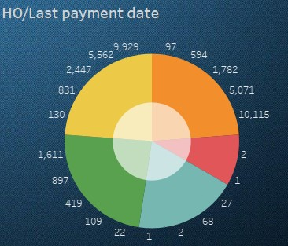
KPI 5 – Home ownership vs Last payment date status
About : This chart displays count of home ownership of borrower.
Observation : This donut chart shows the types of home ownership among loan borrowers, with each type shown in a different color. The data is also broken down by year from 2007 to 2011. A year filter lets us focus on home ownership counts for specific years, making it easy to see trends over time.

Slide 12
Conclusion
The dashboard offers a clear overview of loan distribution, borrower profiles, and repayment trends.
Visualizations help identify high-risk segments, allowing for targeted risk management.
Payment behavior based on borrower verification status is tracked for better insights into payment reliability.
These insights support informed decision-making, reduce default rates, and enhance overall financial performance.

Slide 13
Thank You

